Slide 1
Other Children’s Book Awards
Dianna Jo Crawford - 2016

Slide 2
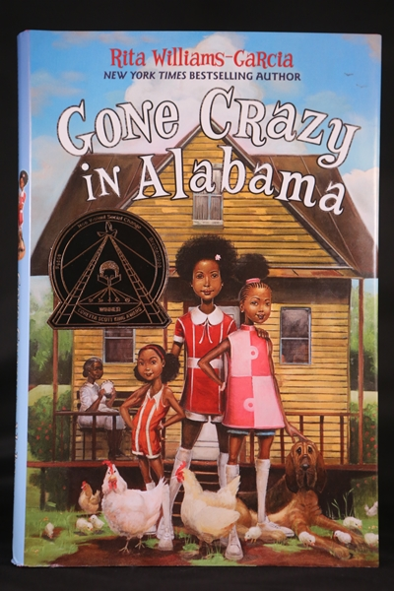
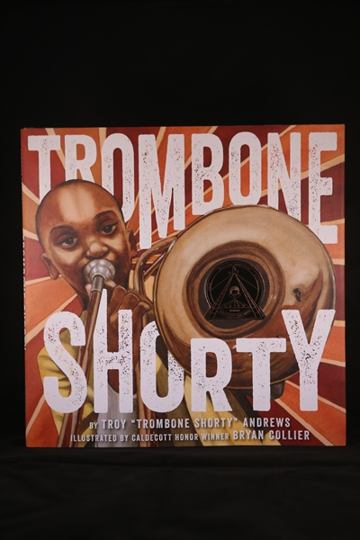
The Coretta Scott King Book Awards are given annually to outstanding African American authors and illustrators of books for children and young adults that demonstrate an appreciation of African American culture and universal human values. The award commemorates the life and work of Dr. Martin Luther King, Jr., and honors his wife, Mrs. Coretta Scott King, for her courage and determination to continue the work for peace and world brotherhood.
http://www.ala.org/emiert/cskbookawards

Slide 3
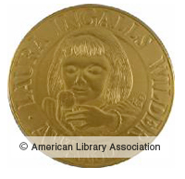
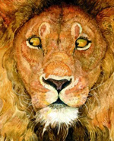
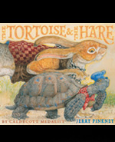
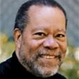
The Wilder Award honors an author or illustrator whose books, published in the United States, have made, over a period of years, a substantial and lasting contribution to literature for children.
http://www.ala.org/alsc/awardsgrants/bookmedia/wildermedal

Slide 4
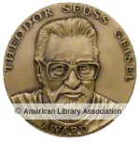
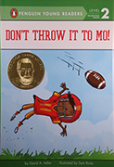
The Geisel Award is given annually to the author(s) and illustrator(s) of the most distinguished American book for beginning readers published in English in the United States during the preceding year.
http://www.ala.org/alsc/awardsgrants/bookmedia/geiselaward

Slide 5
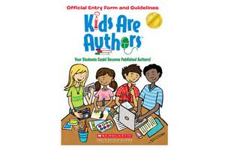
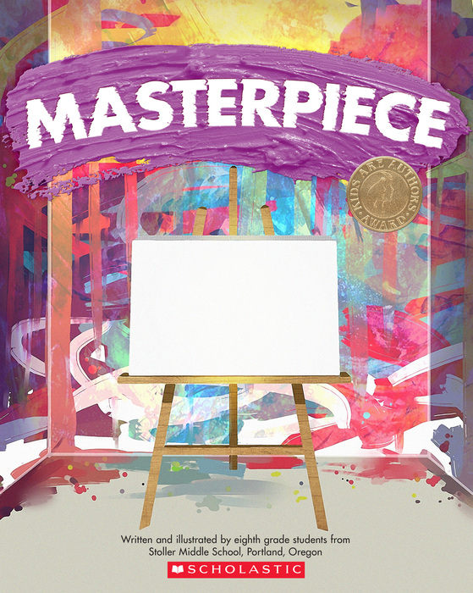
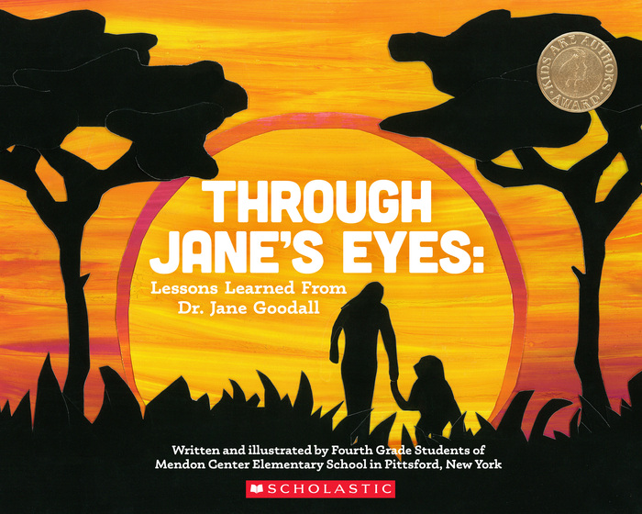
Kids Are Authors Award
http://www.scholastic.com/bookfairs/news/kids-are-authors-winners

Slide 6
To learn about other award-winning children’s books click here!

